Slide 1



Mail access protocols
user
agent
e-mail access
protocol
user
agent
SMTP
SMTP
(e.g., POP3, IMAP, HTTP)
Alice
sender’s e-mail
server
receiver’s e-mail
server
Bob
SMTP: delivery/storage of e-mail messages to receiver’s server
mail access protocol: retrieval from server
POP3: Post Office Protocol –Version 3 [RFC 1939]: authorization, download
IMAP: Internet Mail Access Protocol [RFC 3501]: more features, including manipulation of stored messages on server
HTTP: gmail, Hotmail, Yahoo!Mail, etc.

Slide 2
POP3 Protocol
S: +OK POP3 server ready
C: user bob
S: +OK
C: pass hungry
S: +OK user successfully logged on
Authorization Phase
client commands:
user: declare username
pass: password
Transaction Phase
client commands:
list: list message numbers
retr: retrieve message by number
dele: delete
quit
C: list
S: 1 498
S: 2 912
S: .
C: retr 1
S: <message 1 contents>
S: .
C: dele 1
C: retr 2
S: <message 2 contents>
S: .
C: dele 2
C: quit
S: +OK POP3 server signing off
server responses
+OK
-ERR
Update Phase

Slide 3
POP3 Protocol
At the transaction phase, a user agent can be configured to:
“download and delete” mode
Like the example in the previous slide
The email message is downloaded locally and deleted from the server once you retrieves it. The copy you downloaded is your only copy.
Bob cannot re-read the messages from other machines as it has been deleted from the mail server.
“download and keep” mode
Leaves the messages on the mail server after downloading them
Bob can re-read messages from different machines
POP3 is stateless across sessions
Simple protocol, but limited functionality
Still in widespread use
Notes:
During a POP3 session between a user agent and the mail server, the POP3 server maintains some
state information. But POP3 server does not carry state information across POP3 sessions.

Slide 4

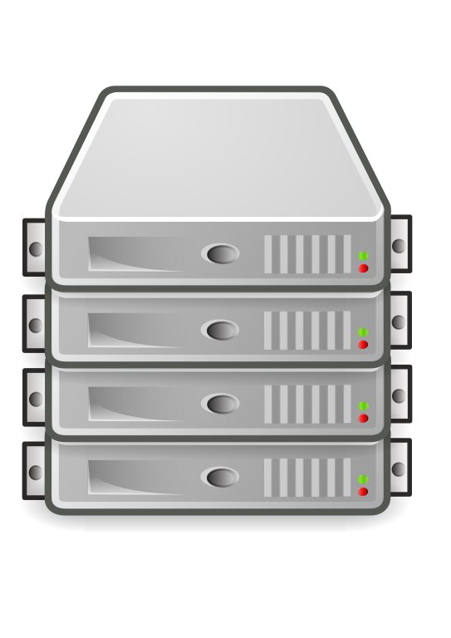


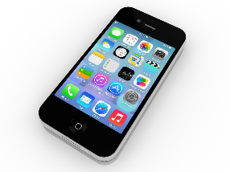
POP3: download and delete mode
X
Mail server
New email
No email
EMTPY

Slide 5
IMAP
Has more features than POP3 and more complex
Keeps all messages in one place: at server
Allows user to organize emails in folders
With POP3 this would be achieved locally, on the client-side
However, IMAP allows this to be done remotely on the mail server
All changes are synchronized with the mail server and any email clients you are using
Keeps user state across sessions:
Names of folders and mappings between message IDs and folder name
IMAP also allows parts of a message to be retrieved
Particularly useful with low bandwidth connections
Avoid fetching attachments, for example
Notes:
POP3 protocol does not provide any means for a user to create remote folders and assign messages to folders.

Slide 6
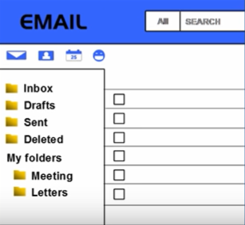
IMAP synchronization
X
Mail server
New email
Folders are synchronized
X
Notes:
Internet Message Access Protocol (IMAP) lets you view your email folders the same way on any device, as it’s all synchronized from a central server. With IMAP, your inbox, sent, and customized folders look alike, and have the same content, whether you’re checking mail on your phone, tablet, or PC.
The Post Office Protocol version 3 (POP3), on the other hand, is specifically designed for downloading email from your email provider’s server to your local machine. Your actions aren’t synchronized with the server like they are with IMAP; it’s just a “dumb” download.

Slide 7
Web-based Email
Provided by Google, Yahoo!, Hotmail
User agents becomes the web browser
Communicates with the mailbox using HTTP
The email will be sent from the mail server to the browser using the HTTP protocol, rather than POP3 or IMAP
Similarly, when a message is sent, this is passed from the browser to the server, again over HTTP
However, a mail server still sends messages to and receives messages from other mail servers using SMTP.

